Slide 1
Evaluation under uncertainty
Use of Bayesian Belief Networks

Slide 2
The challenge we faced…
Evaluate now the effectiveness and value for money of a programme where
  results are uncertain and non-linear
  results realised in the medium- to long-term (+5-7 years) – if at all
  programme contribution = small (but hopefully significant)
  Programme contribution is heavily conditioned by ‘other’ factors
  Easily observable ‘objective’ data for changes promoted not readily available
Tackled the problem from several angles…
this talk is about one aspect: use of Bayesian belief networks

Slide 3
Where the challenges led us…
A strong conception of likelihood
Subjective data need to be treated with transparency and rigour
Ditto issues of strength of influence and uncertainty
“Theory of change” a useful model
  But acknowledge ‘packages’ of influencing factors [establishing the joint-probabilities] [INUS combinations]
…Suggests the BBN approach would be ‘interesting’

Slide 4
Evaluating likelihoods
Certain outcomes/impacts can only be understood/examined as increased or decreased likelihoods e.g.
  Interventions that try to lower the chance of a species extinction
  Looking to raise the likelihood of establishing an effective transboundary management mechanism for an international river
  Reducing the ‘expected’ number of fatalities caused by some kind of natural disaster (were it to happen)

Slide 5
VFM under uncertainty
Donors have comparative advantage in bearing risk in trying to unlock real-world, complex collective action problems (‘wicked’ issues).
  Interest in VFM is legitimate but shouldn’t (perversely) stop them from doing this
Where success is very uncertain, ‘failure’ cannot automatically equate to “poor VFM”
=>
Need a better handle on (at least) two key elements:
  the likelihood of success; and
  funder’s appetite for failure (risk)

Slide 6
ToC <-> Influence map
Quasi-theory based
  testing whether the programme’s stated ‘theory’ was valid, to what extent and in which areas was it stronger/weaker
  we knew that the programme was not going to cause ‘the result’ but influence ‘things’ that advanced the cause
  a way to link those ‘things’ and aggregate influences
Transforms to the influence map [link to fuzzy cognitive mapping]

Slide 7
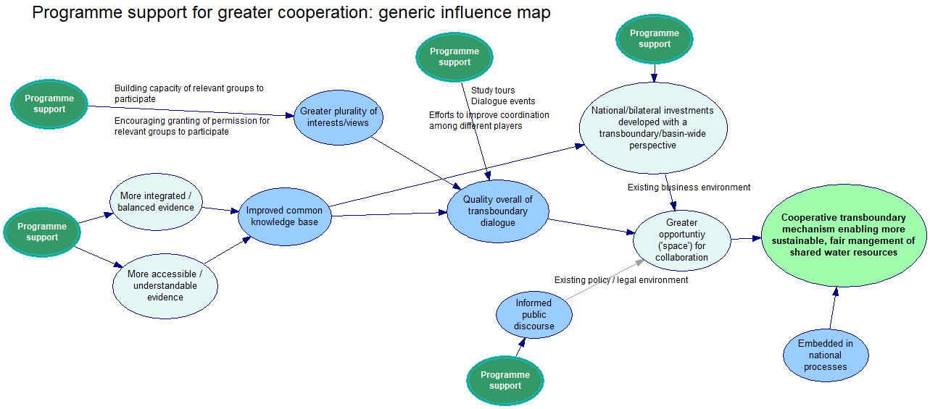

Slide 9
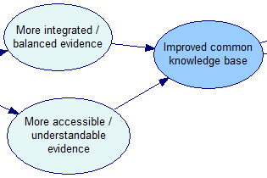
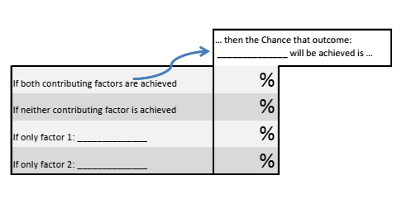
The analytical engine
The approach has two elements
  The influence map (a network)
  The likelihoods/probabilities (a table)
Extracting the ‘Bayesian’ style reasoning
  These are ‘conditional’ probabilities
  They include ‘everything else that is going on not specifically defined on the map’ (important for contribution analysis)
These are both created based on the (largely) subjective data gathered from stakeholders

Slide 11
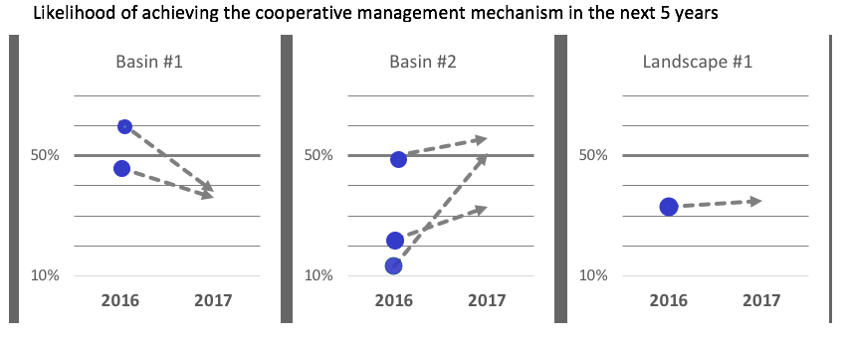
Some example findings /cont…

Slide 12
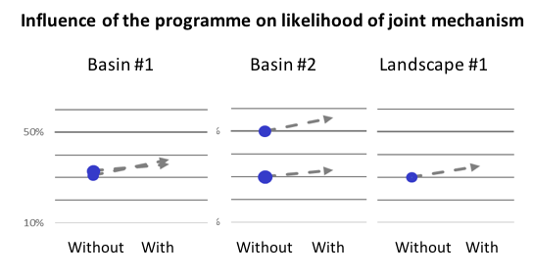
Some example findings /cont…

Slide 13
The generalised features where this can be useful
For programmes where…
on-going, long time frame… [value for developmental evaluation]
complex causal chains – multiple aspects of intervention
high uncertainty about what/works what to – learning on programme and M&E
But also more ‘conventional’ ex post contribution analysis…
what contribution did the whole and/or certain elements make?
  Can talk about how great or small the contribution may be
  Understanding individual and joint contributions to results
…and fiddle around with that (sensitivity, scenarios, sub-intervention elements…)
overlay cost data – examine marginal returns for different areas of effort
…

Slide 14
In perspective
Method in no way presents what will happen/has happened –
  a tool to examine – in detail! – what people’s beliefs to tell us about what is/was important, what are the chances of success, etc
One-time, ex post exercise can yield insights but value comes in repeat exercises for active programmes
  Explore how and why views changing and the the implications for improving or worsening prospects
Influence maps are linear models – they can’t accommodate multidirectional feedback loops
  not the ‘answer’ to evaluating complexity but can potentially help…

Slide 15
Future directions of work
eliciting conditional probabilities in ways that minimise bias risks
ways (and value) of estimating distributions around central estimates
how to aggregate/combine multiple actors’ views
defining and ensuring sufficiently consistent interpretation of ‘occurrence’ and ‘non-occurrence’ of factors of interest
understanding the sensitivity of results to model design and in particular the level of detail

Slide 16
Contact
Simon Henderson -> simon@simonhendersonresearch.com
Stuart Astill -> stuart@astill.net
CECAN -> www.cecan.ac.uk

